Slide 1
Motor Planning
This will help staff:
Understand what motor planning is
Know how you might notice if someone is having difficulties with motor planning skills
Select activities to support those who are having difficulties

Slide 2
About These Skills
Unless we are learning a new skill, our movements become automatic.
Motor planning is developed through experience; a child will learn to stand, balance, take a step, walk, then run and jump and so on.
Each skill is learnt and used to further develop mastery over movement ability for new actions.
Motor planning is the ability to:
Have the idea for the movement required
To be able to organise movements for the activity
To sequence the movements in a coordinated manner and
To know through feedback from the body if the action has been completed correctly with the ability to adjust to the demands of the task.

Slide 3
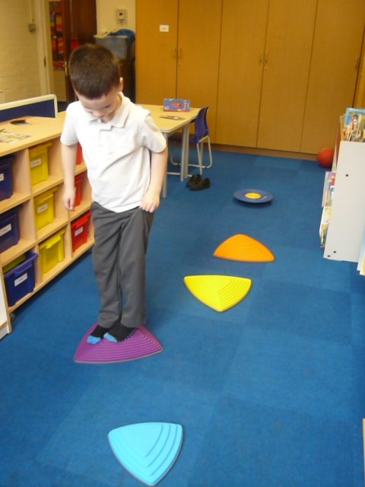
About Motor Planning
Motor planning is highly complex, but a normal part of development.
Difficulties in this area have a significant impact on the ability to complete everyday tasks.

Slide 4
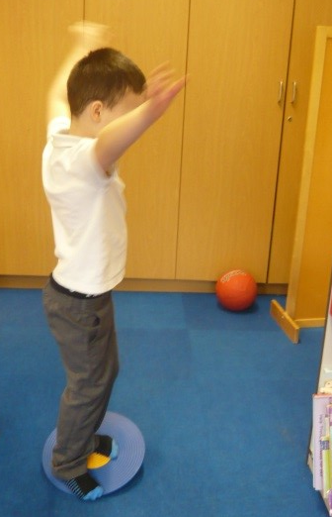
Challenges with Motor Planning
The child may present as:
Awkward and clumsy when moving around
Untidy in appearance
Avoidant of new tasks
During tasks, the child can describe what they need to do but they have difficulty carrying out the actions
Delayed in handwriting development
Unable to complete construction activity
The class clown to distract from their difficulties
Having difficulty with dressing and feeding themselves
Consistently making the same mistakes
Delayed in fine motor skills

Slide 5
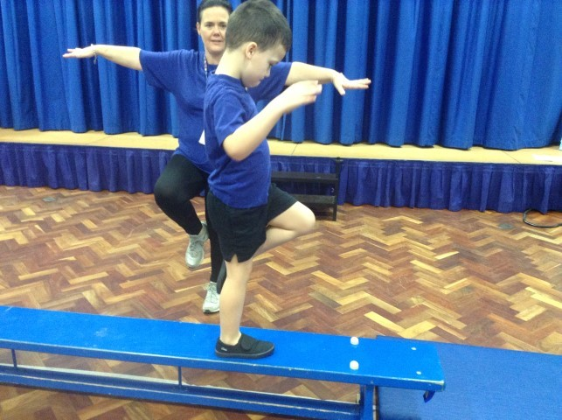
Activities to Support
Activities to support a child with motor planning difficulties can be completed with a whole class, small groups or individually.
Providing movement based activity will enable the brain to receive information about movements to aid laying down of motor memory to develop motor skills.
Repetition is very important for children with this difficulty.

Slide 6
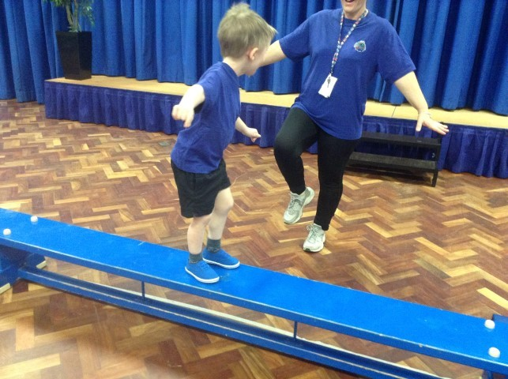
Activities to Support
Sensory motor circuits in a small group with support – see Movement: Sensory section.

Slide 7
Activities to Support
Encouraging dressing in front of a mirror

Slide 8
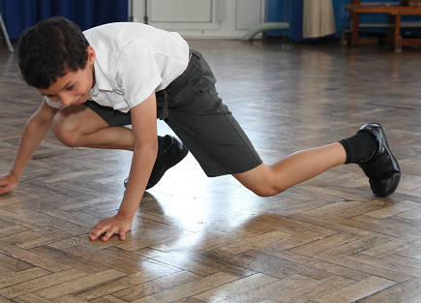
Activities to Support
Animal walks

Slide 9
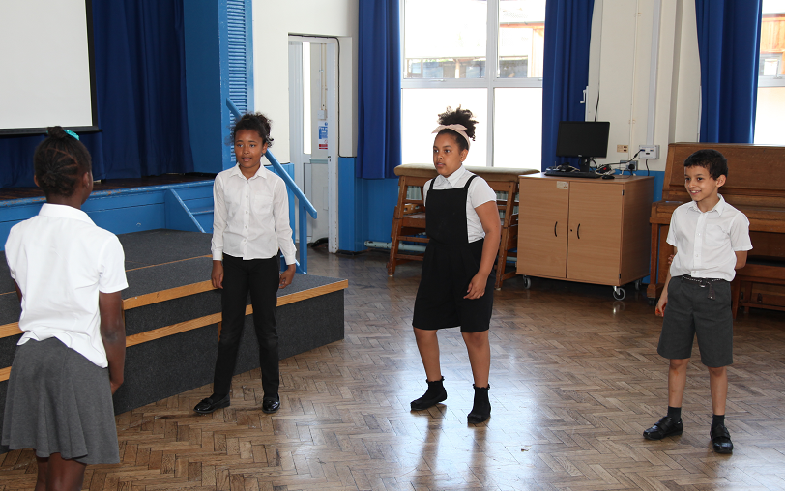
Activities to Support
Movement to sequences – Simon Says

Slide 10
Activities to Support
Completing movements in slow motion while talking through it

Slide 11
Activities to Support
If learning a new skill, encourage the child to:
Say what they need to do
Have a go and then
Discuss how it went and what could be done differently

Slide 12
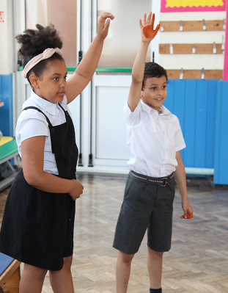
Activities to Support
Buddy the child with someone who will encourage the them to practice.

Slide 13
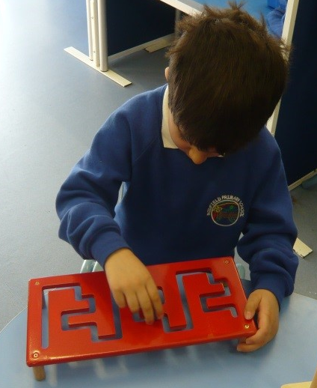
Activities to Support
Complete fine motor activities – see Movement:Handwriting and other activities.

Slide 14
Activities to Support
Complete Body Awareness activities – see Body Awareness page – in a small group.

